Slide 1



(Independent Connector)
Generate test data quickly and load using Power Automate
Notes:
This is my first time submitting a connector to the independent connector program and I choose to do it for Mockaroo, which is a site that I use all the time to generate sample data for my application.

Slide 2






Richard A Wilson (RAW)
Principal Consultant
Microsoft Federal
PowerAppsRAW.com
Twitter.PowerAppsRAW.com
LinkedIn.PowerAppsRAW.com
YouTube.PowerAppsRAW.com
Github.PowerAppsRAW.com
Notes:
I’m an MVP alumni
Been having fun with the Power Platform since Dynamics CRM 3.0
Some links to my social media so please feel free to check them out.

Slide 3
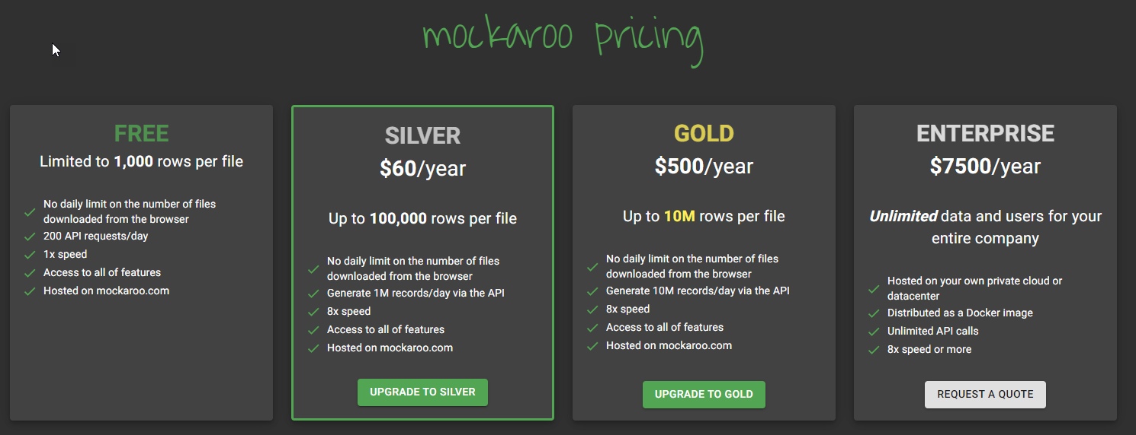
Mockaroo Features
Schemas – Create customized data schemas using a large collection of pre-configured data types or bring your own with datasets
Datasets – If you have existing data you want to reference in your schemas you can upload and utilize them
Mock APIs – Generate a mock API from your schemas to quickly start developing UI components
Projects – Group your schemas/datasets and share them with others
Notes:
Pricing
Free tier is 1000 records per API call and up to 200 api calls per day.

Slide 4
Demo
Power Automate
Basic Flow - Load Contacts
Advanced Flow - Load Contacts and Accounts
Canvas App/Power Automate
Simulated data in apps using ParseJSON (experimental) function in Canvas Apps Power Fx: Introducing ParseJSON | Microsoft Power Apps Introduction to Parse JSON in Power Apps (Reza Dorrani)
Notes:
Making data re-usable

Slide 5

Learn More
Mockaroo - Random Data Generator and API Mocking Tool | JSON / CSV / SQL / Excel
Independent publisher certification process (MS Docs)
Independent Publisher connectors step by step (Tomasz Poszytek)
Provides detailed instruction on how to create your connector and submit it for publication.
Power Platform Connectors for VS Studio (Daniel Laskewitz)
Includes snippets to speed up your connector development
Build and Submit an Independent Publisher Connector in Under 60 Minutes (Troy Tailor)
Notes:
This being the first time I have submitted a connectors I used a couple different sources to figure out the process which includes the MS Docs site as well as some YouTube instruction.
If you like taking a code-first approach to building out connectors I would also definitely recommend Daniel’s VS Studio Extensions which provide you all the snippets you need for creating these connectors quickly.

